Slide 1

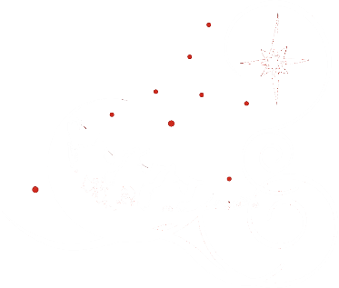
M.A.J.interviews
BUILDING A BETTER JOB MARKET

Slide 2

For the budding junior developer, the scariest bug to fix can be finding that first job.
Which company should you pursue and what have others said about that company?

Slide 3

CONCEPT
That’s why The Three Wise Men have developed MAJi, a user-generated job-interview application that:
Provides useful information on the major tech companies in the greater Atlanta area (local),
Allows you to enter and view the user reviews of fellow job seekers.

Slide 4

Description:
MAJi combines ratings from two of the top job sites, indeed and Glassdoor, and displays them for the user to help the budding developer choose where to interview. We even include diversity ratings from Zippia.

Slide 5

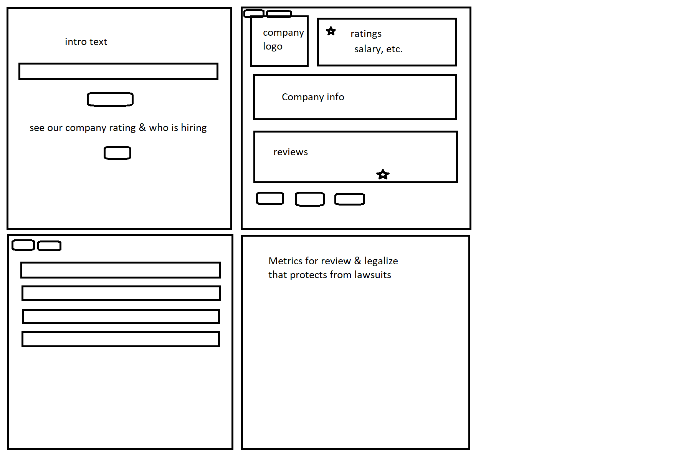
Users visit the site, enter a company
and are directed to a page detailing
the company’s ratings and
reviews.
Users can then enter their own
interview ratings for that company.

Slide 6

TECHNOLOGIES:
SEQUILIZE
NODE.JS
AJAX
JQUERY
MySQL
Bootstrap
Travis.AI
Express

Slide 7



ROLES
Jack “The Wise” Markwalter – API specialist responsible for route calls & JS interactions.
Alan “The Cunning” Elam – MySQL magician responsible for database interactions.
Micah “The Sage” Evans – User design & front-end warrior responsible for the site’s look.

Slide 8

CHALLENGES
Proprietary JOB APIs – Thanks, Capitalism!
URL calls and page load
Interactions between API calls
Advanced project scope
Star-rating & PHP
Our old enemy, TIME!

Slide 9

SUCCESSES
Great group interaction
Good separation of tasks
API interaction
Front-end design
Database interaction

Slide 10

M.A.J.i Demo
BUILDING A BETTER JOB MARKET

Slide 11
Future Development
BUILDING A BETTER…well, APP
Replacing the DB with a proprietary jobs API with open jobs
Ability to leave more robust reviews/ratings for each company:
First-impressions rating, Interview-test difficulty, etc.
Full Jobs Listing page
Expand past the Atlanta Market
User authentication for reviews

Slide 12
Links
Deployed
GitHub repo
Heroku

